Slide 1

Introducing Mergon
Who we are & What we do

Slide 2

Mergon Overview
Innovators in Plastics
Mergon designs, develops and manufactures sustainable, innovative components and systems for the automotive, industrial and healthcare sectors globally.

Slide 3


Mergon
Locations
USA
Mergon Corporation
Established 1998
210 Employees
Ireland – HQ
Mergon International
Established (Plant 1) 1981
Established (Plant 2) 1994
Established (MiCentre (Innovation Centre)) 2015
260 Employees
Czech Republic
Mergon Czech
Established 2004
160 Employees
China
Mergon China
Established 2020

Slide 4

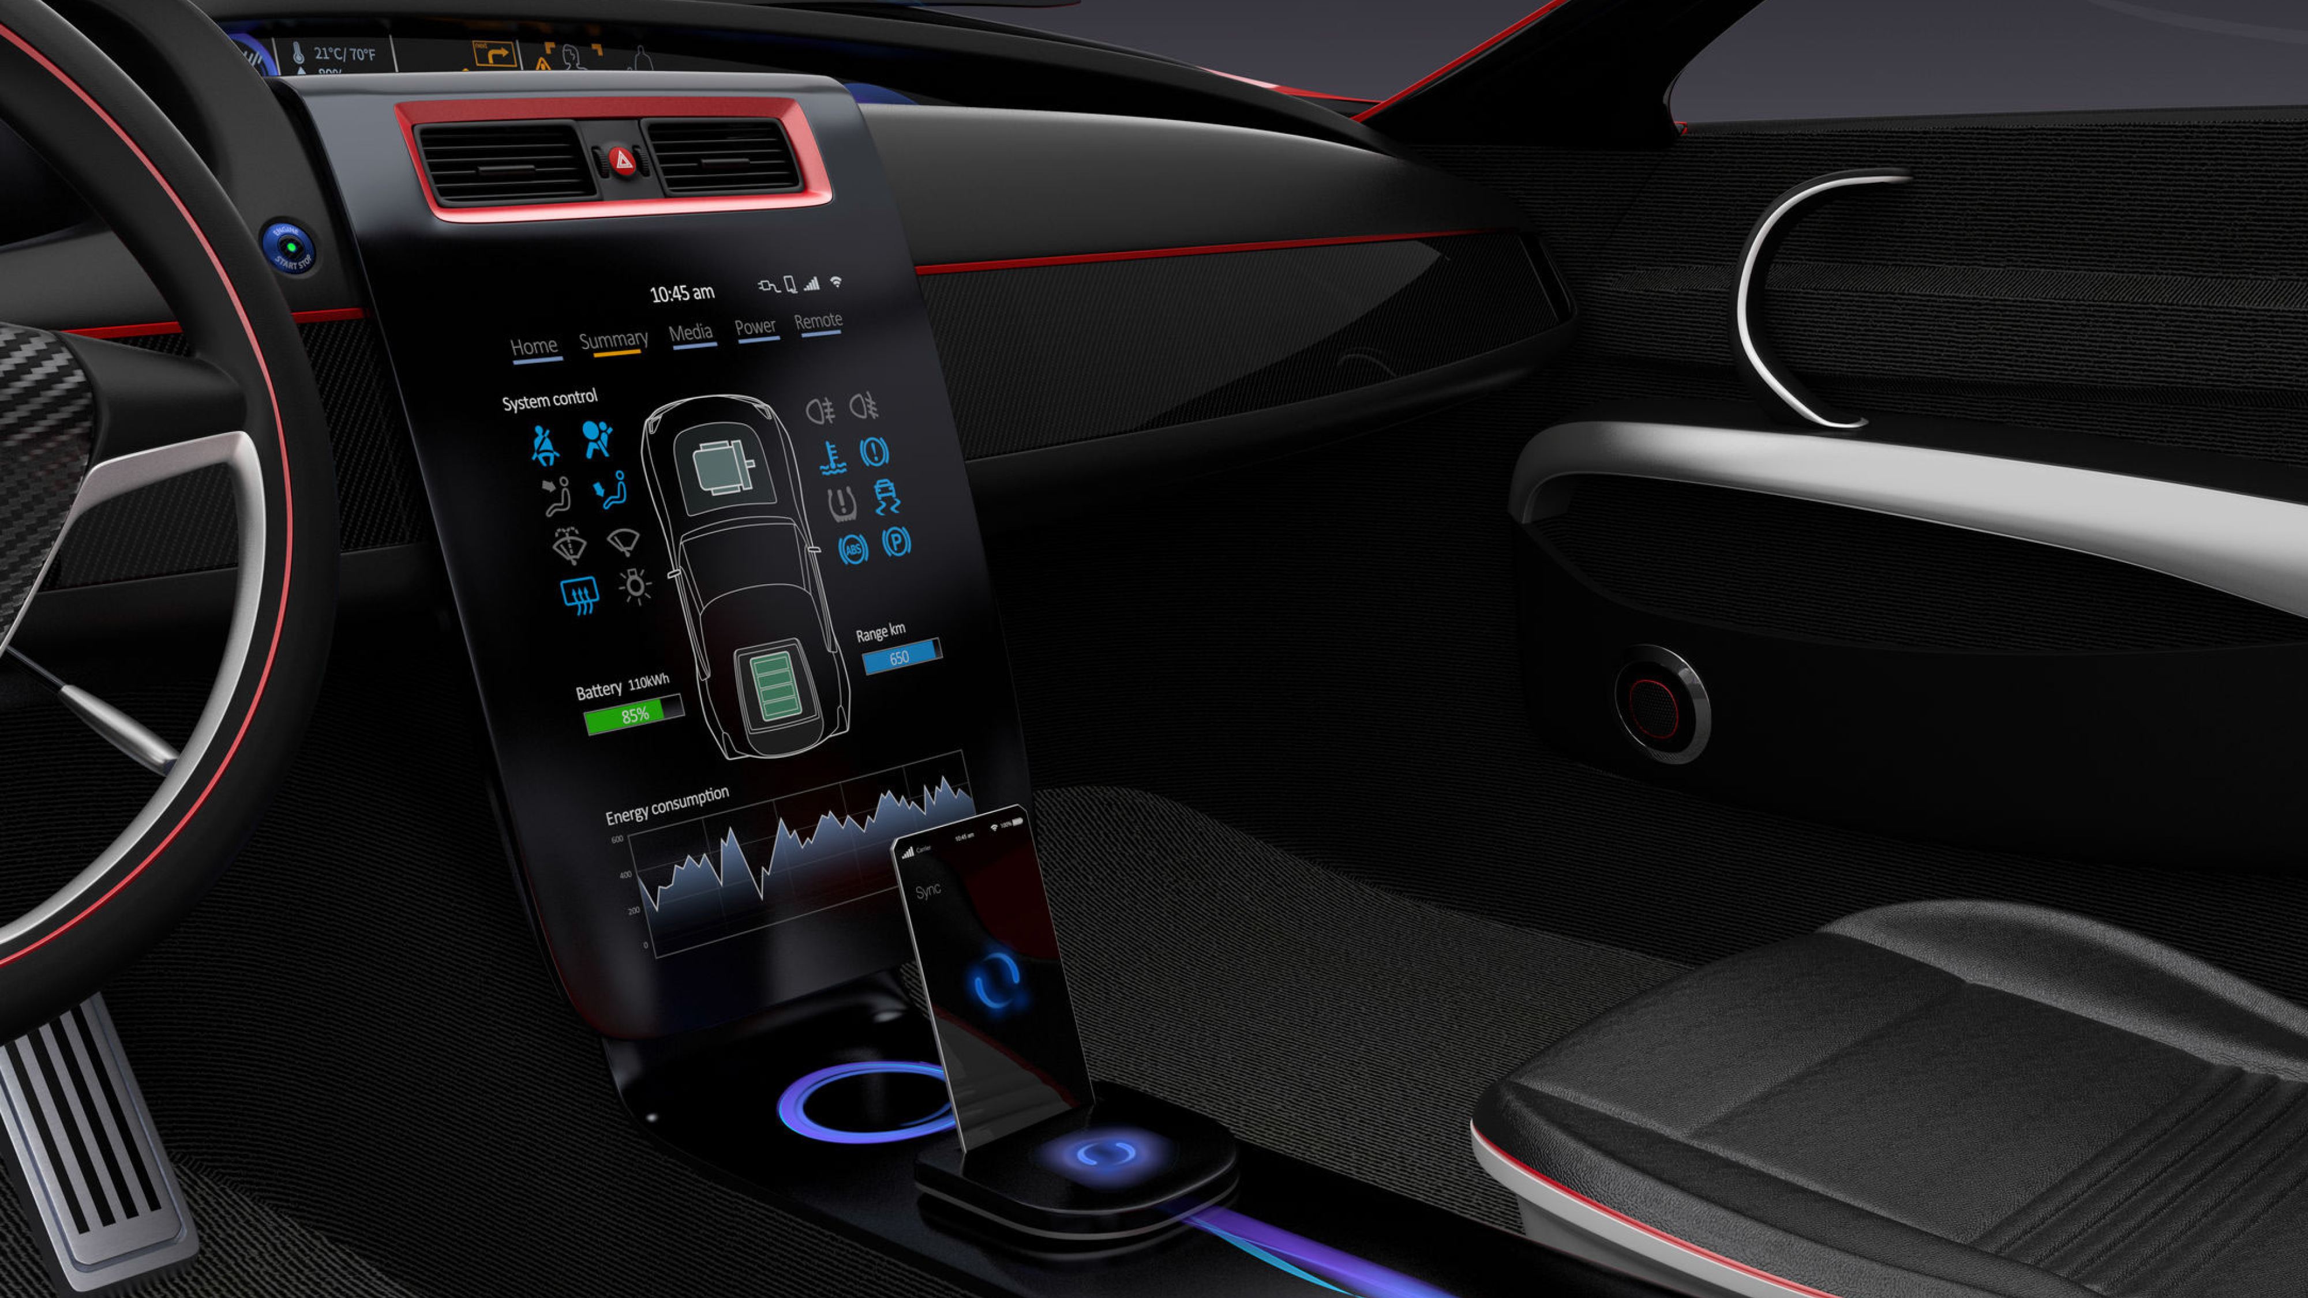



Automotive
59% Group Sales
Traditional & Challenger Brands
Partner with Winners

Slide 5
















Automotive A-Z
The main drivers of innovation

Slide 6
Automotive Overview
Future Proofing Mergon in a turbulent industry
Population of SUVs increasing
Deliberate positioning to win SUV business – more € content/vehicle
Lightweighting & design expertise very desirable
Targeted selection of EV/disruptors
Tesla – now 3rd biggest customer
  Gigafactory 3 – Shanghai, China
  Gigafactory 4 – Berlin, Germany (opening end 2021)

Slide 7
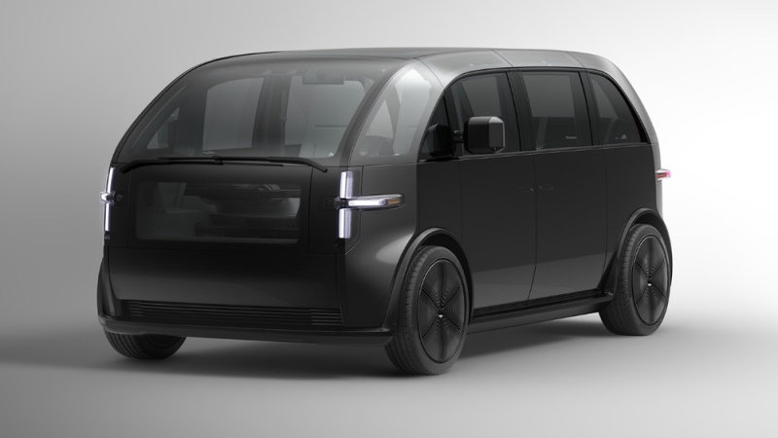
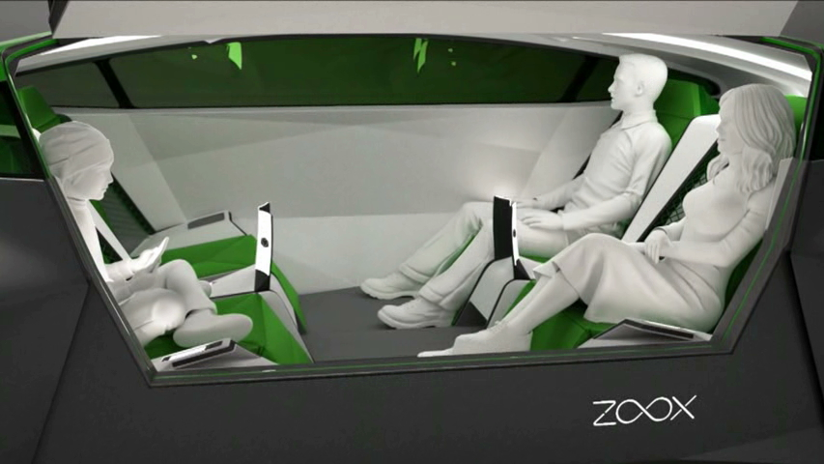
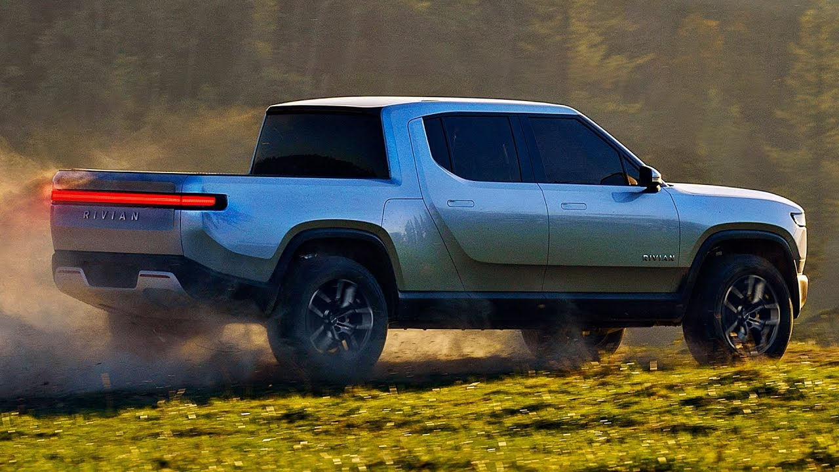
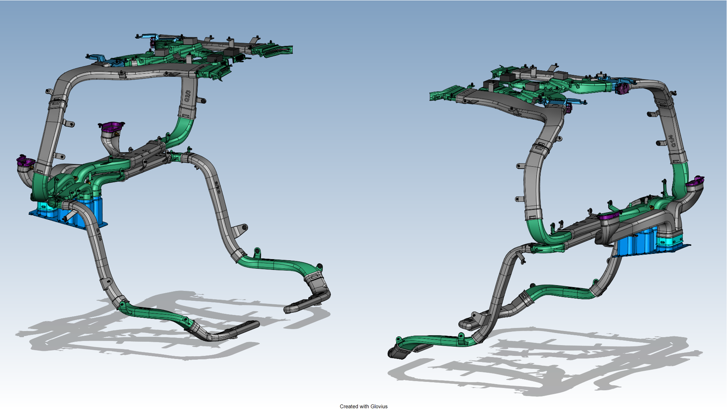
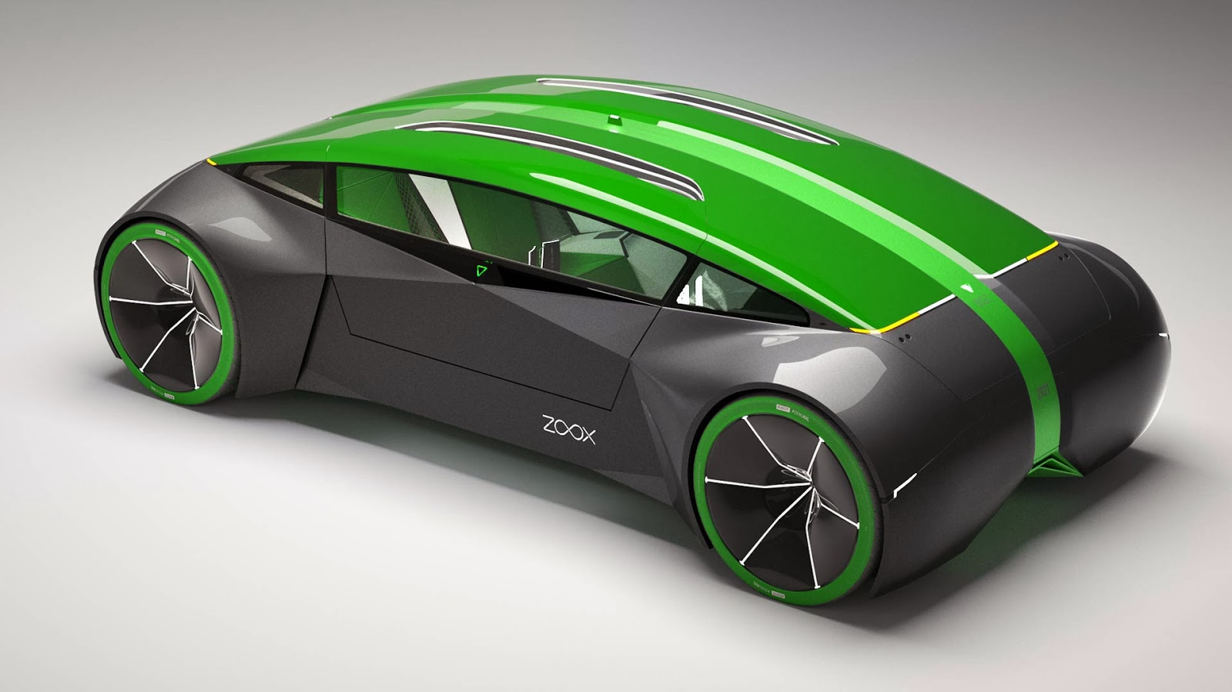
Air Management Systems
Our growth markets:
Increase in SUVs = more air ducts
Recycled materials = sustainability
Growing market for future mobility
Major opportunities for Mergon to grow

Slide 8

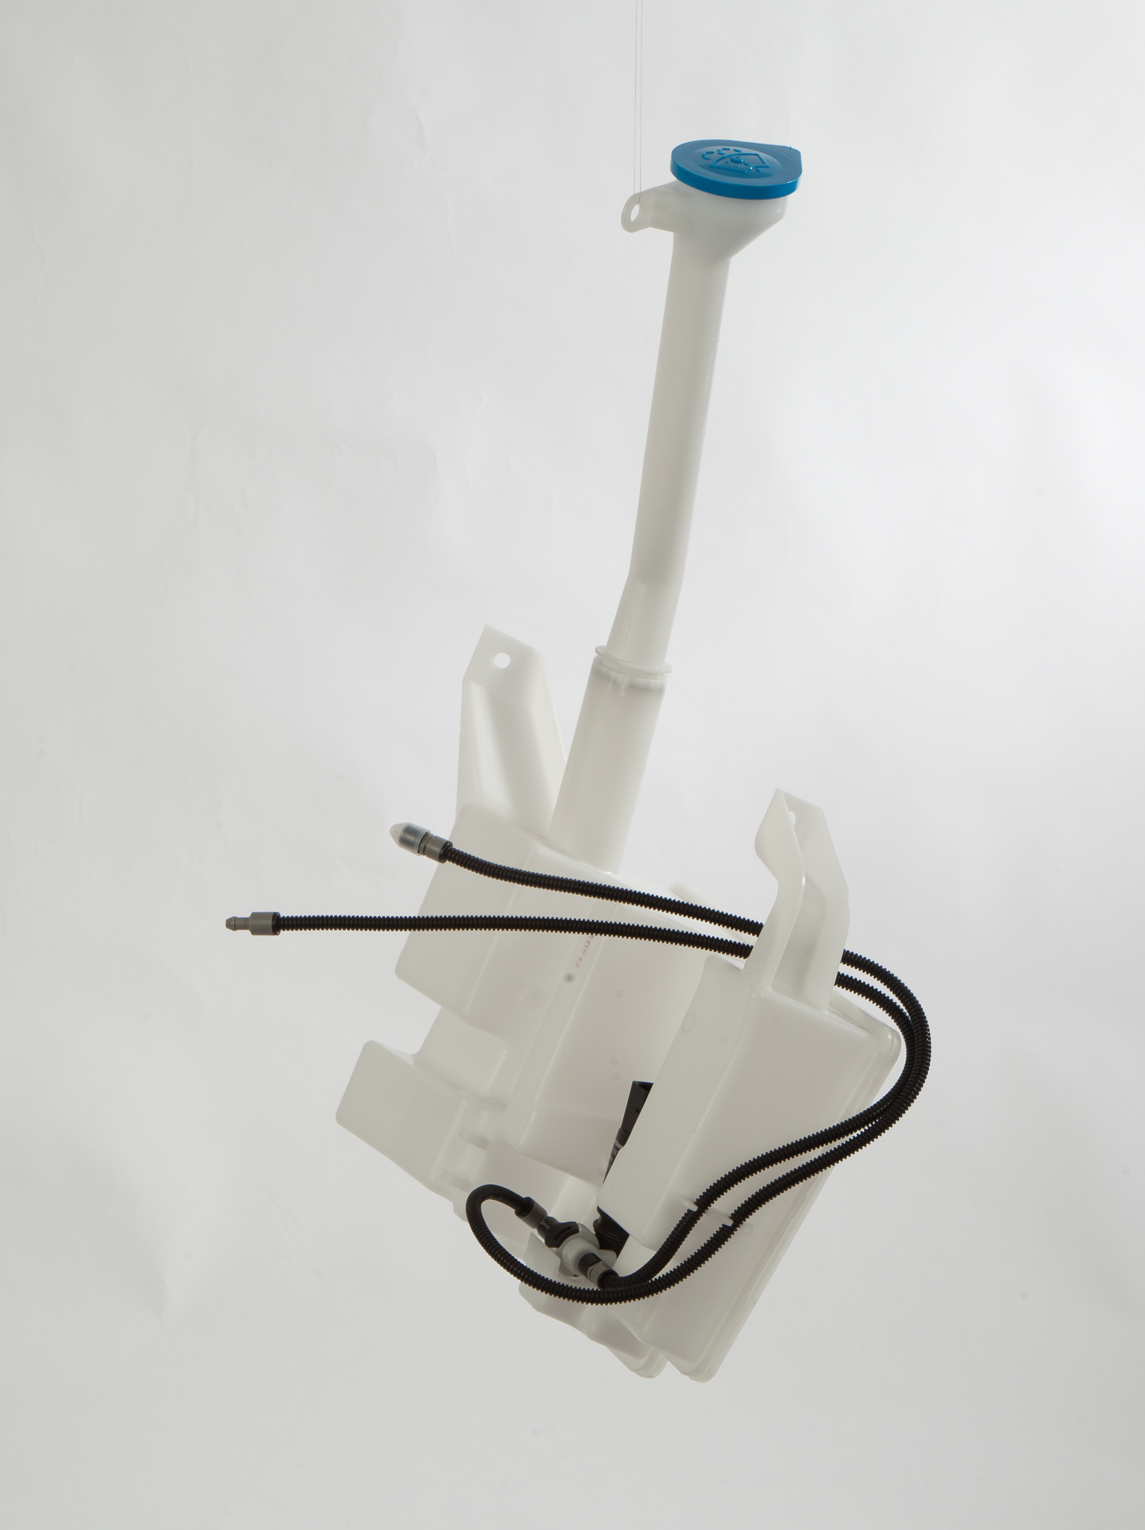
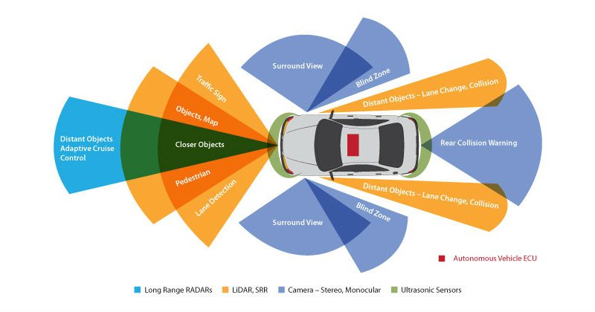
Enhanced Clear Vision Systems
Our growth markets:
Expansion of washer system market
Lidar, radar, sensor, camera cleaning
Growing market for future mobility
Major opportunities for Mergon to grow

Slide 9
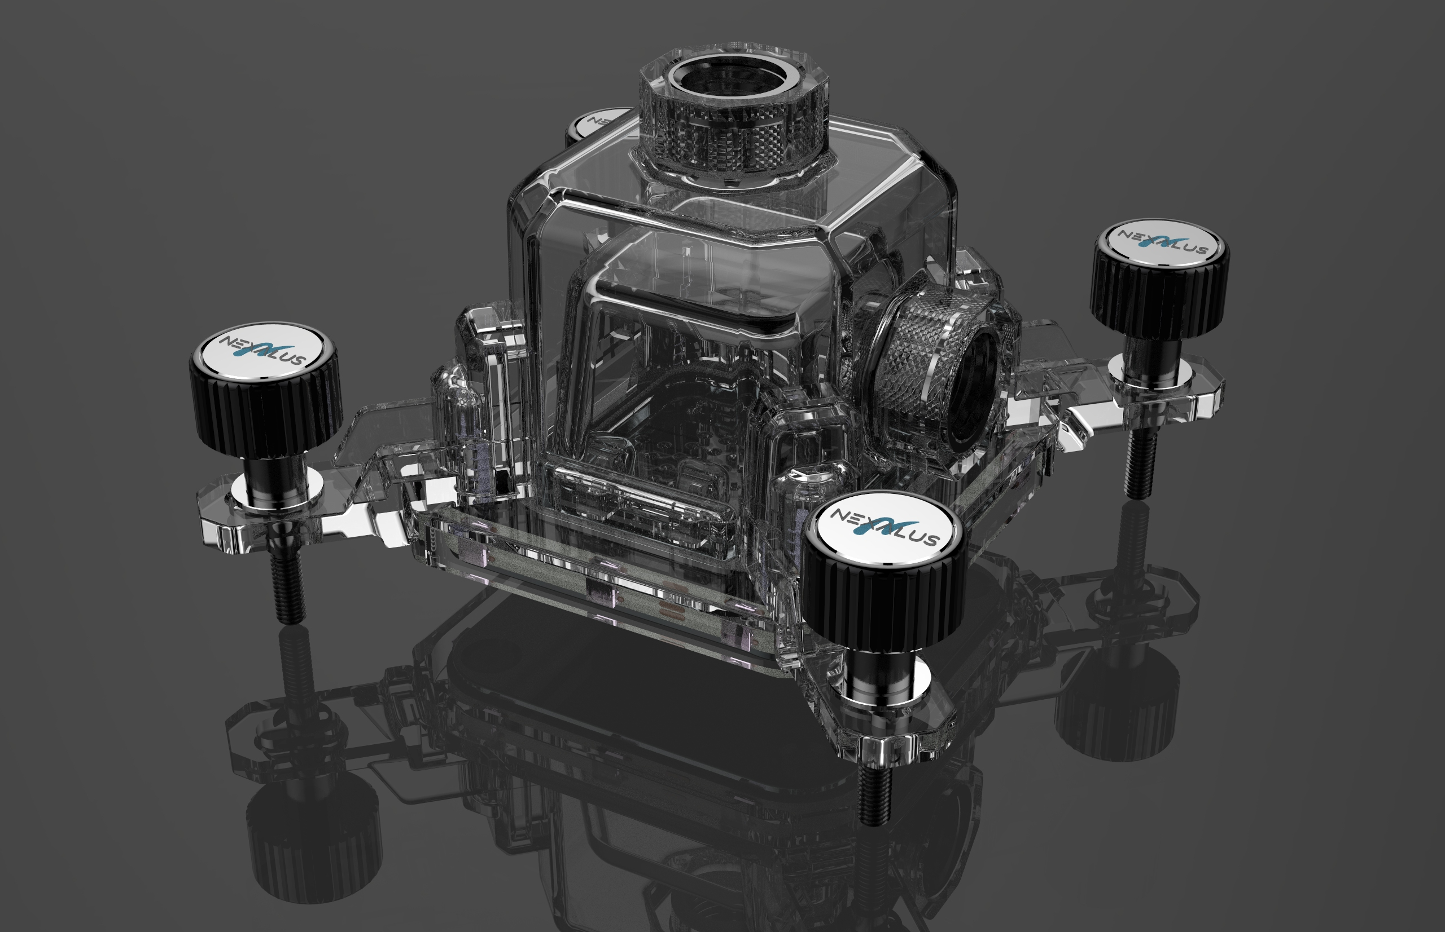

Advanced Electronics Cooling
Sector Diversification
Novel jet propulsion water cooling for CPUs, GPUs
Multi-industry disruptive capability
Incredible market growth potential -
  Gaming
  Data Centres
  EDGE Computing

Slide 10
Contact:
Martin Kováč
Sales Manager
martin.kovac@mergon.com
+ 420 725 464605

